Slide 1
Juuling, Dripping, Dabbing and More:
What School Professionals Need to Know About Vaping
Fall 2020

Slide 2
What you need to know
Vaping basics
What’s the appeal?
Hooking a new generation
Vaping by the numbers
Why the concern?
Government oversight
Actions schools can take
Additional resources
Notes:
In today’s discussion, we will begin with defining and describing what vaping is, the various kinds of vaping devices and how they work, as well as vaping’s appeal, especially for youth. There is a great deal of discussion (and misinformation) in the news about the relative safety of vaping, including the actions the federal government and others are taking to safeguard the public.
Lastly, we will talk about how to protect our young people, and actions school professionals can take if teens and young adults have begun vaping.

Slide 3
Vaping Basics

Slide 4
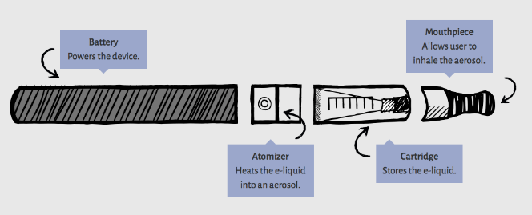
What is vaping?
Vaping is the act of inhaling and exhaling the aerosol, often referred to as “vapor,” produced by an e-cigarette or similar device. Components include:
  Cartridge or reservoir to hold a e-liquid
  Heating element (atomizer)
  Power source (battery)
  Mouthpiece to inhale
4
Notes:
Vaping is inhaling an aerosol using an e-cigarette or similar device. In most devices, puffing activates the heating component, which vaporizes the liquid or oil in the cartridge. The person then inhales and exhales the resulting aerosol.
What’s good about e-cigarettes is that they do not produce tobacco smoke, which is the most dangerous component of smoked cigarettes.
But the term vaping is misleading because these devices don’t produce pure water vapor. The aerosol actually consists of many chemicals and fine particles, many of which are toxic and dangerous, and seep deep into the lungs and bloodstream when vaping.

Slide 5
Cig-a-Like | Variations | Vape Pens | Mods | Pod-Based
E-cigarettes came onto the market around 2007. Most delivered nicotine and were disposable. | Variations on the first e-cigarettes included products like e-hookah and rechargeable versions. | These have batteries that can reach higher temperatures, have refillable e-liquid cartridges and allow users to control how often they inhale. | Large size modifiable e-cigarettes allow for more aerosol, nicotine and other chemicals to be breathed into the lungs at a faster rate. | These e-cigarettes look like USBs and contain disposable pods with higher amounts of nicotine than previous generations.
Cig-a-Like
Variations
Vape Pens
Mods
Pod-Based
Source: Science News for Students
Notes:
There have been several generations of vape devices:
The first generation, Cig-a-likes, looked like cigarettes including having the end light up with a red glow. Later versions offered the capability to recharge and reuse the unit.
Second generation devices offered longer battery life and the ability to use e-liquids of choice.
Third generation devices, called mods, look like a walkie talkie and have the benefit of even longer battery charge and the ability to customize many of the component parts. These devices produce the huge clouds you see on the street.
The fourth generation products are pod-based. They look like flash drives, are rechargeable using USB ports and use disposable pods that contain flavorings, nicotine or THC.

Slide 6

JUUL: the iPhone of vapes
JUUL - $14.99 plus $15.99/pack of 4 pods
Pod flavors: Menthol, Virginia and Classic Tobacco
Contain 3% or 5% nicotine = 1+ pack of cigarettes or 200 puffs
6
Notes:
JUUL, currently the most popular brand of vape devices on the market, has a sleek design which is easy to conceal. JUUL initially offered a variety of kid-friendly flavors like mango, mint and fruit, but only menthol and tobacco flavors are for sale now as a result of pressure from the U.S. government (the Food and Drug Administration).
ALL of them contain nicotine and each pod that is used has a dose of nicotine equivalent to a pack of cigarettes or more.
JUUL’s product also uses nicotine salts with the dual purpose of providing for a smoother inhalation (reducing coughing, as many people do when first smoking or vaping) and increasing the intake of nicotine.

Slide 7
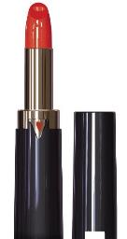
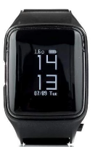

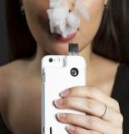
Other vape devices
Notes:
Vapes now come in designs that look like Apple watches (Uwell vape watch), lipstick, hoodies and iPhone cases, making them increasingly difficult to detect.

Slide 8
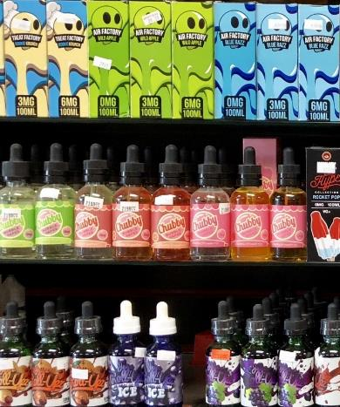
What is being vaped?
Flavored liquids including chemicals like glycerin and propylene glycol
Flavored liquids with varying levels
of nicotine
Flavored liquids with vitamins and
essential oils
Leaf marijuana, THC oil/wax
Notes:
There are four kinds of e-liquids most commonly used for vaping (presenters should note that almost any drug can be vaporized):
There are more than 15,500 flavored e-liquids which are appealing to kids (e.g., cotton candy, grape, Skittles and weird flavors like hot dog and king crab legs).
Flavored e-liquids with varying amounts of nicotine – more about this in the next slide.
E-liquids with vitamins and essential oils like B12 and melatonin. Inhale Health LLC is one of at least 20 companies promoting vapable vitamins, caffeine, melatonin and essential oils as wellness products.
Marijuana can be vaped in the dry leaf, wax (also known as dabs) and oil forms and, in many cases, with flavorings (Note: THC is the active ingredient in marijuana that provides the “high”).

Slide 9



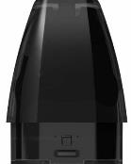
The nicotine “arms race”
1 pack of Cigarettes
≈ 20 mg of inhaled nicotine
1 JUUL pod
≈ 41.3 mg of nicotine
1 PHIX pod
≈ 75 mg of nicotine
1 Suorin pod
≈ 90 mg of nicotine
= 20
Cigarettes
= 44
Cigarettes
= 75
Cigarettes
= 90
Cigarettes
Source: Science News for Students
Notes:
This compares the concentrations of nicotine in pods as compared to traditional cigarettes. The newer vape devices hold more nicotine than most traditional cigarettes. For example, each JUUL pod contains 41.3 milligrams of nicotine which is equal to smoking 26 to 40 conventional cigarettes (depending on how they are puffed).
Other companies on the market are providing even higher concentrations of nicotine as pictured here with PHIX and Suorin.
_____________
Source: Raloff, J. (2019, December 19). Today’s nico-teen addicts: What role does ‘juuling’ play? https://www.sciencenewsforstudents.org/article/juul-e-cig-vaping-nicotine-teens-addiction

Slide 10

Vape devices for marijuana and oils
Notes:
These are some of the devices used to vape marijuana and its concentrates.
The one on the left is a PAX. This can be used to vape both dry leaf marijuana and oils, although it’s relatively costly at over $200.
The device next to it is used for dabs. Dabs (also known as wax) are concentrates of THC placed directly onto the coils of the vape device and, when heated, produce vapor for inhalation.
The third device is used with THC oils, the active ingredient in marijuana, housed in a cartridge.
The one on the right is actually not a vape device, but rather an inhaler called the AeroInhaler. It comes in flavors like Grape Ape, Sour Diesel and Tangerine Haze. The company advertises it as providing metered doses to consumers, and it is available for purchase in recreational dispensaries where marijuana is legal.
_____________
Source: https://adai.uw.edu/marijuana/factsheets/potency.htm

Slide 11


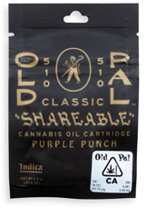

Disposable marijuana vape pens and cartridges
Delivered to your door by Eaze
Source: adai.uw.edu
Notes:
This picture is of a disposable vape pen (left) and cartridge (right) for sale on the Eaze website with THC potency upward of 70%. By comparison, the average potency of THC in dry leaf marijuana is about 17%. Like nicotine, we are seeing greater concentrations of THC in newer products.
Eaze promotes their products as health products with ads like “Hello marijuana, goodbye anxiety” or ”Hello marijuana, goodbye insomnia.”
_____________
Source: Chandra et al. (2019). New trends in cannabis potency in USA and Europe during the last decade (2008–2017). https://link.springer.com/article/10.1007/s00406-019-00983-5

Slide 12
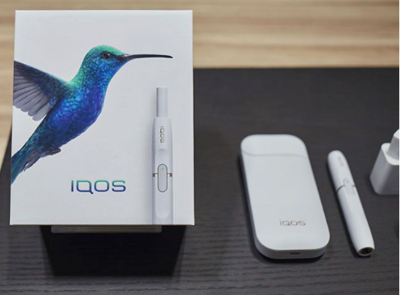
A new device: Philip Morris International’s IQOS
IQOS is a “Heat, Not Burn” Device
Notes:
IQOS, which stands for ‘I Quit Original Smoking,’ are electronic devices that heat tobacco leaves to produce an inhalable aerosol instead of either burning tobacco, as traditional cigarettes do, or heating nicotine and other chemicals, as vaping products do.
Although these products are electronic devices, the U.S. Food and Drug Administration has classified them as cigarettes, which means they must follow the same regulations and restrictions as traditional cigarettes. These products expose users to serious health risks.
_____________
Sources:
FDA (2019, April 30). FDA permits sale of IQOS Tobacco Heating System through premarket tobacco product application pathway. https://www.fda.gov/news-events/press-announcements/fda-permits-sale-iqos-tobacco-heating-system-through-premarket-tobacco-product-application-pathway
https://openres.ersjournals.com/content/5/1/00159-2018

Slide 13
How do youth get vaping products?
Sources of e-cigarettes among students who vaped in the past 30 days (2018)
Friend
Vape shop
Family member
Gas station/convenience store
Person other than family member or friend
Online
59%
17%
13%
10%
9%
6%
U.S. law now prohibits the sale of tobacco products, including e-cigarettes, to anyone under age 21
Notes:
It’s relatively easy for youth to get vape products despite efforts to reduce access among young people.
Selling any tobacco product, including e-cigarettes, to anyone under age 21 is illegal according to federal law, as of December 2019. However, clerks at tobacco shops, vape stores, gas stations and convenience stores do not always follow the law.
A recent national survey of middle and high school students found that, among those who reported using e-cigarettes in the past 30 days, 59% got them from a friend, 17% from a vape shop, 13% from a family member, 10% from a gas station or convenience store and 9% from someone who is not a family member or friend. About 6% got them online.
Although few kids buy them online, another study found that doing so is pretty easy with a 90% success rate, since website age gates are easy to get around.
_____________
Sources:
Liu et al. (2019). Youth access to tobacco products in the United States, 2016-2018. https://www.ncbi.nlm.nih.gov/pubmed/31745494
Williams et al. (2015). Electronic cigarette sales to minors via the internet. https://www.ncbi.nlm.nih.gov/pubmed/25730697

Slide 14
Slang terms
Analog: tobacco as the old physical or "analog" version
Juul, Pax, NJOY, Puff Bars, Stigs: styles/brands
Atty: atomizer to heat e-liquid
Cart: cartridge that holds the e-liquid
Carto: cartridge and atomizer combined into a single unit
Cloud chasing: e-cigarette/mod users tweak their hardware and liquid selections to produce ever bigger and thicker clouds of aerosol
Draw: amount of force required to accommodate inhalation through the mouthpiece of an e-cigarette
E-liquid, smoke juice: the liquids that are vaporized when using an e-cigarette
PV: personal vaporizer, often the mod style
Notes:
There are many slang terms young people use to describe vaping that you might find in texts or on social media.

Slide 15
More slang terms
O/Ohm: standard unit of electrical resistance
PG: propylene glycol is used as a diluent (a filler and diluting agent)
TH: throat hit is the sensation an e-cigarette user (and tobacco smoker) may experience when the aerosol hits the back of their throat
VG: vegetable glycerin acts as a diluent, or filler, and is a common ingredient found in e-liquid
Notes:
O/Ohm: A lower number indicates lower resistance and therefore faster heating of a coil, as a result of higher wattage.
PG: Used in the production of e-liquids associated with delivering the throat hit.
VG: VG has a light, sweet taste, low toxicity, and is thicker than PG. Glycerin is used at higher ratios in juices when thicker, richer vapor production is desired or where a PG sensitivity of the user is present.

Slide 16
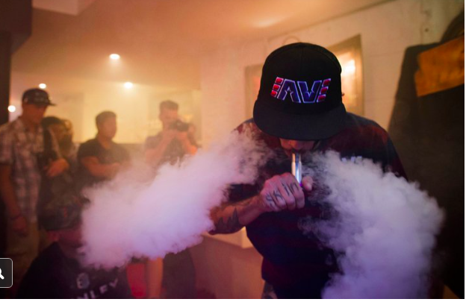
More slang - dripping
Apply nicotine liquid directly to heated coils of e-cig or vaporizer
Produces thick clouds of nicotine vapor and a stronger “throat hit”
Notes:
In dripping, the nicotine liquid is manually applied to the vape device’s inner coil, rather than allowing it to flow there via an automatic wick system. This results in thicker clouds of aerosol than other ways of vaping and a stronger “throat hit.”
_____________
Source: Fortin, J. (2017, February 7). Plain Old Vaping Gives Way to ‘Dripping’ Among Teenagers, Study Says NY Times

Slide 17
What’s the appeal?

Slide 18
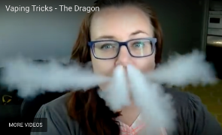
Why teens vape
Curiosity (55%)
Friend or family member vapes (31%)
Flavors (22%)
Vaping tricks (21%)
Less harmful than other tobacco products (16%)
Discreet, can be used anywhere (14%)
Peer pressure (11%)
To try to quit other tobacco products (6%)
Easier to get than other tobacco products (5%)
Famous people use them (4%)
Source: CDC, 2019
Notes:
A 2019 national survey of middle and high school students who reported using e-cigarettes found that the most commonly selected reasons for use were:
Curiosity (55%)
Friend or family member use (31%)
Flavors: “such as mint, candy, fruit, or chocolate” (22%)
Vaping tricks (21%) - the picture is a young girl doing “The Dragon,” a popular vaping trick
_____________
Source: Wang et al. (2019). Tobacco product use and associated factors among middle and high school students — United States, 2019.
https://www.cdc.gov/mmwr/volumes/68/ss/pdfs/ss6812a1-H.pdf

Slide 19
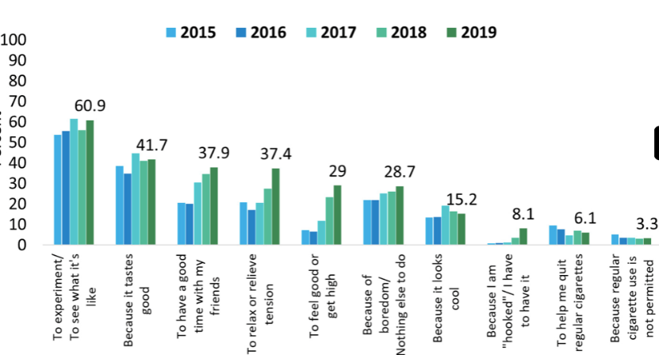
Reasons for vaping
Source: Monitoring the Future 2019, 12th grade responses
Notes:
The 2019 Monitoring the Future survey from the National Institute on Drug Abuse asked 12th graders why they vaped. Like the previous slide of CDC data, curiosity was cited as the primary reason, followed by the appeal of flavors, having a good time with friends and helping them cope with stress and boredom.
I want to draw your attention to the category circled showing the dramatic rise in the number of 12th graders who report they have to vape because they are addicted (8.1% -- more than double the 3.6% who reported this reason in the 2018 survey).
_____________
Source: National Institute on Drug Abuse. (2019). Monitoring the Future Survey: High school and youth trends.
https://www.drugabuse.gov/publications/drugfacts/monitoring-future-survey-high-school-youth-trends

Slide 20
Are we hooking a new generation?

Slide 21
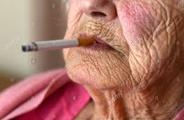

How is the tobacco industry going to replace older smokers?
90% of adult smokers began smoking before age 18
95% of those with nicotine addiction began smoking
before age 21
Notes:
Like cigarette companies, vape companies have focused their efforts on young people. Why? Getting a person to start as a teen can make a lifetime customer. It’s well known among health professionals and the tobacco industry alike that adolescence is the peak time period to develop addiction.
The vast majority of adult smokers started smoking during adolescence and nearly all people with nicotine addiction began smoking before age 21.
During the teen and young adult years, the brain is undergoing significant changes. Teens are becoming more efficient and developing critical thinking skills. Exposure to any addictive product, including nicotine or marijuana, at any early age makes the brain more susceptible to the continued use of the product and addiction.
By planting the seeds for nicotine addiction as early as possible, the tobacco industry has tremendous incentive to bring its decades of experience and insights into how best to hook young people on nicotine and hide the harms associated with nicotine products.
_____________
Sources:
Campaign for Tobacco-Free Kids. (2020). Raising the tobacco age to 21. https://www.tobaccofreekids.org/what-we-do/us/sale-age-21
National Center on Addiction and Substance Abuse. (2011). Adolescent substance use: America’s #1 public health problem. https://drugfree.org/reports/adolescent-substance-use-americas-1-public-health-problem/

Slide 22
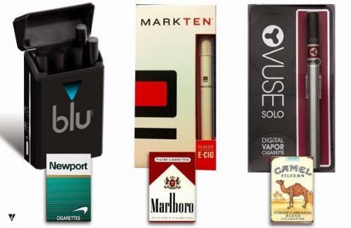
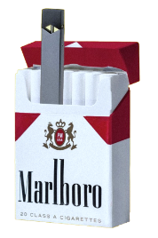
Big tobacco behind popular vaping products
Notes:
The major cigarette companies either have big stakes in or already own many of the more popular vape brands. They are targeting the age group they’ve traditionally relied on to sustain their business: teens and young adults (as well as current, heavy smokers).
They’re also helping to bolster the future market for their cigarettes by addicting young people to nicotine through vaping. They benefit as these same kids switch to cigarette smoking or use both products simultaneously, which most people who vape end up doing.

Slide 23
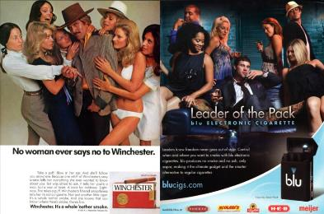
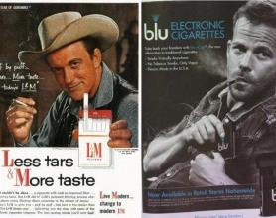




Tobacco + e-cigarettes: advertising
Notes:
The similarities in some cases between cigarette and e-cigarette ads are remarkable – in each of these panels, the image on the left is a classic cigarette ad while the image on the right is a comparable ad for a vaping product.
Like they did for cigarette ads for years and years, they use celebrity spokespeople, they feature good-looking models, they advertise on social media channels popular with youth, and they sponsor sports events and music festivals that young people attend.
_____________
Source: Stanford University Research into the Impact of Tobacco Advertising. http://tobacco.stanford.edu/tobacco_main/index.php

Slide 24
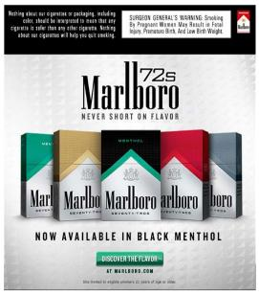
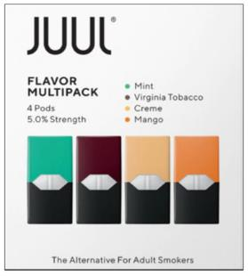
Tobacco + e-cigarettes: packaging
Notes:
Some vaping companies, in this case JUUL, design the packaging of their products in a way that closely resembles popular cigarette brand designs.

Slide 25
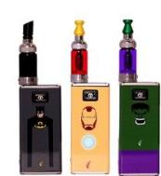
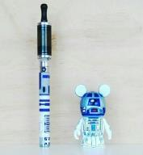



Youth-friendly designs and flavors
4 out of 5 kids who have used tobacco products
started with a flavored product.
Notes:
These are some examples of vaping products with kid-friendly designs.
Vaping products come in a broad array of unmistakably child-friendly flavors, often packaged to resemble well-known candy products.
There are literally thousands of flavors available, many with very delicious names including mango, apple pie, milk chocolate, peanut butter cup, as well as “Unicorn Puke” and “Zombie Juice.”
Why are flavors so important?
They mask the harsh taste of nicotine and other chemicals, making it easier to inhale the aerosol.
Sweet, fun flavors also appeal to kids because they are associated with positive childhood experiences, like parties and treats.
Kids assume the product is less harmful because of the flavorings.
Proponents of allowing flavored e-cigarettes argue that they make it more appealing for cigarette smokers to switch to vaping and that if flavors were banned, adult smokers will be less likely to switch and quit smoking. But recent research contradicts this. Studies of e-cigarette users find that, compared with older adults, adolescents and young adults are more than three times as likely to say they use fruit- and candy-flavored e-cigarettes.
_____________
Sources:
Leventhal et al. (2019). Flavored e-cigarette use and progression of vaping in adolescents. https://pediatrics.aappublications.org/content/144/5/e20190789
Soneji et al. (2019). Use of flavored e-cigarettes among adolescents, young adults, and older adults: Findings from the population assessment for tobacco and health study. https://www.ncbi.nlm.nih.gov/pubmed/30857471
Zare et al. (2018). A systematic review of consumer preference for e-cigarette attributes: Flavor, nicotine strength, and type. https://journals.plos.org/plosone/article?id=10.1371/journal.pone.0194145

Slide 26

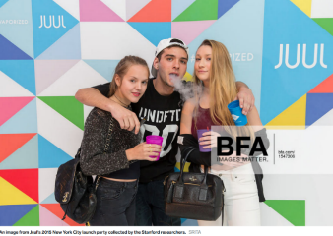

Social media marketing
Notes:
JUUL was masterful in attracting teens and young adults, explaining why it became the most popular brand of e-cigarettes among kids.
JUUL went on sale in June 2015.
Revenues increased almost 800% from 2017 to 2018, with its most explosive growth happening among teenagers.
As of August 2019, JUUL accounted for three-quarters of the market share of e-cigarette products in the United States.
In its first three years on the market, JUUL didn’t bother advertising on TV, radio or in magazine outlets as other vaping companies did because these media sources are all but ignored by kids.
Instead, it went directly to where kids spend most of their time – social media.
JUUL used themes that worked well in the past for the cigarette industry, including ads associating the product with pleasure/relaxation, socialization/romance, style/identity, freedom, rebellion and satisfaction.
The ads prominently featured sweet and fruity flavors, as well as young, cool-looking people, mostly having a great time.
The company also employed known social media influencers as brand ambassadors.
They used numerous hashtags which distributed JUUL’s promotion to a wide audience, including hashtags not directly related to their product, such as #style, #design, #electronics, #technology, #smart and #gadget, broadening their reach and influence even among those not specifically searching for JUUL-related posts.
Although the focus of attention has been on JUUL for its marketing tactics, many other vaping companies used cartoons and other child-appealing strategies in their social media marketing efforts.

Slide 27
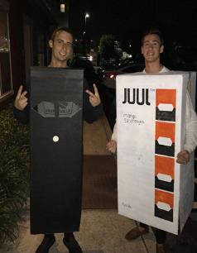
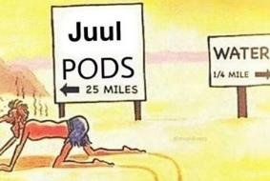
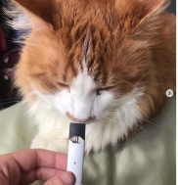


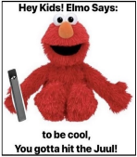
Social media posts and JUUL
Notes:
The federal government recently began to crack down on JUUL’s marketing practices so JUUL removed themselves from social media platforms like Instagram. But kids still post images promoting their product. These pictures found on social media are examples of JUUL’s widespread popularity.
A recent study found a proliferation of JUUL-related content on Instagram, with over half of the posts (55%) containing youth-related content.
In fact, since JUUL closed its Instagram account, the volume of JUUL-related content on the platform has only increased – it’s actually doubled -- according to a Stanford University study.
_____________
Source: Czaplicki et al. (2019). Characterizing JUUL-related posts on Instagram. https://tobaccocontrol.bmj.com/content/early/2019/05/08/tobaccocontrol-2018-054824

Slide 28



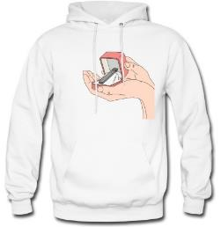
“JUULery”
Notes:
There’s even such a thing as JUULery.

Slide 29
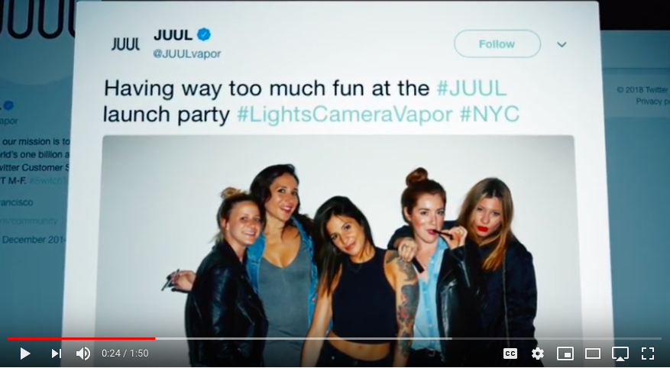
Source: truthinitiative.org
Notes:
Here’s why this should concern you. This is a video from the Truth Initiative, a nonprofit public health organization dedicated to eliminating tobacco use.
_____________
Source:
Truth Initiative (2018). Is JUUL getting a new generation addicted to nicotine? https://www.youtube.com/watch?v=WzGX13YI6P8&feature=youtu.be

Slide 30
Vaping by the numbers

Slide 31
How many people vape?
Percentage of students reporting vaping in the past 30 days (2018-2020)
%
Meanwhile, the intended market, adults, report vaping
at rates consistently and dramatically lower than among kids (only 3.2% in 2019).
Source: CDC
Notes:
The industry’s marketing efforts have paid off.
3.6 million middle- and high school-age kids now vape.
These numbers show a decline from recent years. Still, despite growing public awareness of the risks of vaping, along with increasing efforts by the government, communities, health professionals, schools and parents to prevent and curb vaping among youth, the numbers remain high.
According to the most recently available data from the U.S. Centers for Disease Control and Prevention, on a national level:
19.6% of high school students and 4.7% of middle school students reported vaping within the last 30 days in 2020.
No matter how you look at it, though, a higher percentage of young people than adults report vaping.
Only about 3% of adults (the intended market) report using e-cigarettes.
_____________
Sources:
Wang et al. (2020). E-cigarette Use Among Middle and High School Students — United States, 2020. https://www.cdc.gov/mmwr/volumes/69/wr/pdfs/mm6937e1-H.pdf?deliveryName=DM37503
Dai et al. (2019). Prevalence of e-cigarette use among adults in the United States, 2014-2018. https://jamanetwork.com/journals/jama/fullarticle/2751687

Slide 32
Reports of frequent vaping in the past 30 days
%
A significant proportion of students who reported vaping in the past 30 days in 2020
did so frequently (>20 days) or daily (all 30 days)
Source: CDC
Notes:
Teens are not just experimenting with vaping devices. Many are using it frequently, which is defined here as 20 or more days in the past 30 days.
National data show that kids who use e-cigarettes are using them more and more frequently – 38.9% of high school students and 20% of middle school students who said they vaped in the past 30 days in 2019 said they vaped on at least 20 days a month. This is an increase over previous years. Reports of daily use are also high. Among those who vaped in the past 30 days, 9.4% of middle school students and 22.5% of high school students admitted to vaping daily.
_____________
Source: Wang et al. (2020). E-cigarette Use Among Middle and High School Students — United States, 2020. https://www.cdc.gov/mmwr/volumes/69/wr/pdfs/mm6937e1-H.pdf?deliveryName=DM37503

Slide 33
What are they inhaling?
%
Past Year Use
Source: Monitoring the Future 2019
Notes:
Many teens think they are inhaling harmless water vapor, but research tells us a different story.
The Monitoring the Future survey from the National Institute on Drug Abuse is an annual survey of over 42,000 8th, 10th and 12th graders. The 2019 survey shows vaping nicotine and especially marijuana have increased significantly. In fact, there has been a more than 50% increase in the number of 10th and 12th graders reporting that they vape marijuana.
_____________
Source: National Institute on Drug Abuse. (2019). Monitoring the Future 2019 Survey results: Vaping. https://www.drugabuse.gov/related-topics/trends-statistics/infographics/monitoring-future-2019-survey-results-vaping

Slide 34
Why the concern?

Slide 35
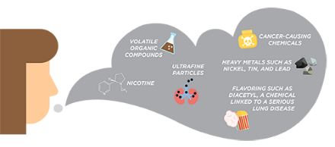
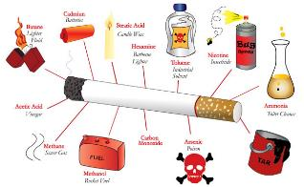
Harmful chemicals: cigarettes vs. vaping
Cigarette smoke contains over 7,000 chemicals, including known cancer-causing (carcinogenic) compounds and hundreds of other toxins
The aerosol created when vaping
contains harmful ingredients:
Nicotine
Ultrafine particles
Flavorings
Volatile organic compounds (e.g., benzene, found in car exhaust)
Heavy metals (e.g., nickel, tin, lead)
Notes:
Cigarette smoke image (left):
At this point, given our current knowledge, e-cigarettes may be less harmful than regular cigarettes because they don’t burn tobacco, which accounts for much of the health risks of smoking. But that doesn’t mean there are no health risks.
Vaping smoke image (right):
Many young people think that vaping produces clouds of water droplets, but that isn’t accurate. It’s more like the aerosol from hairspray.
Although the chemicals that have been found in e-cigarette aerosols might seem unrecognizable, you are familiar with other places some of those same chemicals can be found.
For example, propylene glycol can be found in antifreeze products or in substances used to winterize plumbing systems.
Acetone is commonly found in nail polish remover and as a paint thinner.
Ethylbenzene is often used to make other chemicals. It’s also found in pesticides, synthetic rubber, varnishes, paints and inks.
Formaldehyde-based solutions are also used in embalming to disinfect and temporarily preserve human and animal remains.
Rubidium is a chemical that can be used to give fireworks their bright colors.
A study, published in the journal Nicotine & Tobacco Research, shows when chemical flavorings for vanilla, cherry, citrus and cinnamon mingle with solvents such as polypropylene glycol and glycerol, they create new compounds called acetals, which are linked to irritation and inflammation of delicate lung tissue. So even if a bottle or pod of e-juice is labeled with its ingredients, a person vaping won’t know exactly what they are inhaling.
_____________
Source: Hanno et al. (2018). Formation of flavorant–propylene glycol adducts with novel toxicological properties in chemically unstable e-cigarette liquids. https://academic.oup.com/ntr/article-abstract/21/9/1248/5134068?redirectedFrom=fulltext

Slide 36
So why the concern?
Nicotine itself is harmful
The chemicals in the aerosol are harmful
Risk of progressing to cigarette smoking
Dual use – both vaping and smoking – is common
Risk of addiction
Link to other substance use and addiction
Link to mental health disorders
Recent spate of illnesses and deaths
Notes:
But even if vaping is not quite as harmful as cigarettes, there is still reason for concern. Let’s review why this increasing trend in youth vaping is so troublesome:
Despite what many people think, nicotine itself is harmful.
The chemicals used in e-liquids are highly concentrated and many are dangerous when inhaled.
Vaping makes the transition to cigarette smoking easier and quadruples the likelihood that a teen will take up cigarette smoking.
Many teens and adults who vape are dual users, meaning they’re both vaping and smoking cigarettes, significantly doubling the risks.
Vaping is associated not only with cigarette smoking and other substance use, but with an increased risk of addiction – both nicotine addiction and addiction to other drugs.
It’s also associated with a host of mental health problems.
Now for some more detail on each of these….

Slide 37
Nicotine itself is harmful
Extremely addictive, especially for kids
Addiction sets in quickly
Structurally changes the developing brain
Increases risk of addiction to other drugs
Affects attention, learning, mood, impulse control
Increases blood pressure, respiration, heart rate
Harms nervous, cardiovascular, respiratory, and reproductive systems
Increases risk of developing diabetes
Notes:
Many people wonder whether nicotine is all that harmful. Isn’t it preferable to have people become addicted to nicotine, as long as they’re not inhaling and exhaling deadly tobacco smoke?
Nicotine is highly addictive and especially risky for the developing teen brain, no matter what form it comes in.
Younger users are more likely to become addicted, have more difficulty quitting and are at higher risk for addiction to other substances in the future.
Using nicotine in adolescence can harm the parts of the brain that control attention, learning, mood and impulse control.
Nicotine is a potent stimulant and increases adrenaline, raises blood pressure, speeds up the heart rate and causes the arteries to narrow.
Nicotine also causes respiratory damage and can have a negative effect on reproductive organs.
A recent study found that pregnant women who vape have much higher risk than those who don’t of having smallness-for-gestational-age (SGA) babies. And another recent study links it to a higher risk of developing type 2 diabetes.
_____________
Sources:
Cardenas et al. (2019). Use of Electronic Nicotine Delivery Systems (ENDS) by pregnant women I: Risk of small-for-gestational-age birth. http://www.tobaccoinduceddiseases.org/Use-of-Electronic-Nicotine-Delivery-Systems-ENDS-by-npregnant-women-I-Risk-of-small,106089,0,2.html
Duncan et al. (2019). Habenular TCF7L2 links nicotine addiction to diabetes. https://www.ncbi.nlm.nih.gov/pubmed/?term=Habenular+TCF7L2+links+nicotine+addiction+to+diabetes

Slide 38
Nicotine’s impact on teens
Teen brain reacts differently to nicotine
Chronic nicotine exposure can, among other things, reduce attention span and increase reckless behavior
Effects are less intense and long-lasting in adults
Adolescent
Adult
Enhances locomotor activity
Decreases locomotor activity
Acute Nicotine
More sensitive to rewarding effects
More sensitive to aversive effects
Sensitivity
Display blunted withdrawal symptoms
Nicotine
Withdrawal
Display more severe withdrawal symptoms
Well tolerated; lowers aversion to high doses later in life
High Dose
of Nicotine
Aversive
Enhances acquisition of cocaine, meth and alcohol
Nicotine
Pretreatment
No effects on psychostimulant or alcohol self-administration
Source: Child Mind Institute
Notes:
The adolescent brain reacts differently to nicotine than does the adult brain. Long-term nicotine vaping can reduce attention span and affect other abilities needed for learning and school.
Teens experience enhanced locomotor activity (e.g., walking, running, jumping). They are more likely to find the vaping experience to be rewarding, with fewer withdrawal symptoms than adults.
They tend to tolerate high doses well, which can lead to even more use later in life. And, as noted on the previous slide, it raises the risk of using and becoming addicted to other substances.
_____________
Source: Child Mind Institute

Slide 39
Risk of progressing to cigarettes
Adolescent vaping increases the odds of smoking about fourfold
Among 12- to 15-year olds considered low-risk for smoking, vaping was associated with a 9x increase in their odds of smoking
Sources: Soneji et al., 2017; 2018
Notes:
Teens and young adults who use electronic cigarettes are almost 4 times as likely as their non-vaping counterparts to begin smoking traditional cigarettes, according to a review published in JAMA Pediatrics. The review examined nine studies that included more than 17,000 teens and young adults aged 14 to 30 looking at the progression to cigarette smoking.
Among 12- to 15-year-olds, the risks are even greater.
_____________
Sources:
Soneji et al. (2017). Association between initial use of e-cigarettes and subsequent cigarette smoking among adolescents and young adults. A systematic review and meta-analysis. https://www.ncbi.nlm.nih.gov/pubmed/28654986
Soneji et al. (2018). Quantifying population-level health benefits and harms of e-cigarette use in the United States. https://www.ncbi.nlm.nih.gov/pubmed/29538396

Slide 40
Use of multiple nicotine products is common
1 in 3 middle and high school students who use nicotine products use two or more
Many people who use e-cigarettes to quit smoking become ‘dual users’
Use of multiple nicotine products increases the risk of addiction
Notes:
We’re finding that more and more people who vape are using multiple nicotine products, not just one.
1 in 3 students who use nicotine products reported using two or more — primarily e-cigarettes and traditional cigarettes.
Many who use e-cigarettes to quit smoking become dual users, continuing to smoke cigarettes as they use e-cigarettes.
Using more than one nicotine product increases the risk of nicotine dependence and other tobacco-related health consequences.
_____________
Sources:
Ali et al. (2016). Risk profiles of youth single, dual, and poly tobacco users. https://www.ncbi.nlm.nih.gov/pubmed/26896162
Coleman et al. (2019). Transitions in Electronic Cigarette Use among Adults in the Population Assessment of Tobacco and Health (PATH) Study, Waves 1 and 2 (2013–2015). https://www.ncbi.nlm.nih.gov/pmc/articles/PMC6202279/?report=classic
Owusu et al. (2019). Patterns and trends of dual use of e-cigarettes and cigarettes among U.S. adults, 2015–2018.
https://www.ncbi.nlm.nih.gov/pmc/articles/PMC6861646/?report=classic#b0035
Wang et al. (2019). Tobacco product use and associated factors among middle and high school students — United States, 2019.
https://www.cdc.gov/mmwr/volumes/68/ss/pdfs/ss6812a1-H.pdf

Slide 41
Risk of nicotine addiction
Because of high nicotine content, many who vape can’t stop – nicotine is a highly addictive drug
Vaping is more addictive than cigarette smoking
Nicotine, like all drugs, changes the structure and function of the brain
Addiction risk increases for those with family history or mental health problems
Intense withdrawal symptoms – strong cravings, fatigue, irritability, difficulty concentrating
Notes:
Nicotine addiction can happen swiftly and is extremely hard to extinguish.
Think about how hard it is for an adult smoker to quit: nearly 70% of adult smokers say they want to quit and slightly more than 7% succeed.
Vaping is more addictive than smoking because of the higher doses of nicotine and because the concentrated liquid form is more quickly metabolized than the smoked form.
Nicotine, like all drugs, changes the structure and function of the brain.
Receptors in the brain grab onto the nicotine molecule – acetylcholine, a neurotransmitter that helps with attention and learning – because it’s similar to something we make naturally.
If there is a family history of addiction, or if other family members are using substances like alcohol, tobacco or drugs at home, a teenager’s vulnerability increases.
Teenagers with anxiety or depression can also succumb more quickly.
Finally, the withdrawal symptoms are quite intense, driving people who vape right back to the product, even under the best intentions to quit.
_____________
Source: Truth Initiative. (2018). What you need to know to quit smoking. https://truthinitiative.org/research-resources/quitting-smoking-vaping/what-you-need-know-quit-smoking

Slide 42
Link to other substance use and addiction
Young adults who vaped in the past year:
2x higher odds of having tobacco use disorder
Teens who used e-cigarettes but never marijuana:
2-4x higher odds of marijuana use
Nicotine exposure alters brain and increases vulnerability to other substance use, including marijuana and cocaine
Notes:
Vaping increases the risk of tobacco use disorder and the use of other substances, especially marijuana.
Recent research finds that, among kids who had never used marijuana, any reported e-cigarette use significantly increased the odds of using marijuana a year or two later.
_____________
Sources:
Azagba, S. (2018). E-cigarette use, dual use of e-cigarettes and tobacco cigarettes, and frequency of cannabis use among high school students. https://www.ncbi.nlm.nih.gov/pubmed/29291507
Chadi et al. (2019). Association between electronic cigarette use and marijuana use among adolescents and young adults: A systematic review and meta-analysis. https://www.ncbi.nlm.nih.gov/pubmed/31403684
Dai et al. (2018). Electronic cigarettes and future marijuana use: A longitudinal study. https://pediatrics.aappublications.org/content/141/5/e20173787
Kandel & Kandel. (2014). A molecular basis for nicotine as a gateway drug. https://www.nejm.org/doi/full/10.1056/NEJMsa1405092
Olfson et al. (2019). E-cigarette use among young adults in the U.S. https://www.ncbi.nlm.nih.gov/pubmed/30885517

Slide 43
Vaping-related illnesses
Shortness of breath, weight loss, fatigue, gastrointestinal problems and lung failure
As of February 2020
  Nearly 70 deaths; 2,800 illnesses
  Across 50 states, DC and U.S. territories
EVALI:
e-cigarette, or vaping product use associated lung injury
On the black market, vitamin E acetate is sometimes added as a cutting agent, decreasing the amount of THC in vape cartridges. It is linked to most cases of EVALI, but not all.
Source: CDC
Notes:
You may have heard the recent reports of vaping-related serious lung disease and even deaths throughout the country.
The symptoms include shortness of breath, unexplained weight loss, fatigue and gastrointestinal issues.
This spate of illnesses and deaths has been given a name by the CDC – EVALI.
The statistics as of February, 2020 are that nearly 70 people have died and more than 2,800 have fallen ill from a vaping-related lung disease.
Most of the illnesses and deaths trace to the use of black market THC, but not all. It’s believed that Vitamin E acetate, which is a cutting agent to make the e-liquid look thicker with greater THC potency is the primary culprit.
_____________
Source: CDC. (2020). Outbreak of lung injury associated with the use of e-cigarette, or vaping, products. https://www.cdc.gov/tobacco/basic_information/e-cigarettes/severe-lung-disease.html

Slide 44

Hard metal lung disease
When the metal coils of e-cigarettes heat up to turn e-liquids into aerosols, toxic metals like nickel, aluminum, manganese, lead, cobalt and chromium can leach into the liquid
Coil under 2,000x magnification using an electron microscope
At 150 burns, it shows pitting and flaking
Notes:
Researchers and regulators are carefully looking at vaping devices in their effort to determine the source of the outbreak of lung injuries. Many of the devices are manufactured in China without U.S. government or third-party safety checks. The devices may be releasing toxic chemicals, particularly if they are held together with lead or cadmium solder.
When the metal coils of electronic cigarettes heat up to turn e-liquids into aerosols, toxic metals can leach into the liquid, leading to a rare condition usually only seen in industrial metal workers.
_____________
Sources:
Fels Elliott et al. (2019). Giant cell interstitial pneumonia secondary to cobalt exposure from e-cigarette use. https://erj.ersjournals.com/content/54/6/1901922
Source of photo: Dr. Michelle Peace: NDEWS webinar series, Timely topics: The current state: vaping, devices, and e-liquids. https://ndews.umd.edu/resources/timely-topics-current-state-vaping-devices-and-e-liquids

Slide 45
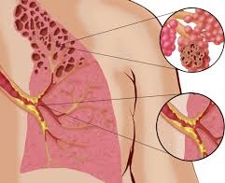
Bronchiolitis obliterans
Diacetyl, found in the majority of e-liquids, linked to “popcorn lung”
Popcorn lung: inhaled chemicals scar tissue in the lungs, making it difficult to breathe
First known case in teen who vaped for five months
“Popcorn Lung”
Notes:
Bronchiolitis obliterans: pronounced braang·kee·ow·lai·tuhs -ə-ˈblit-ə-ˌranz
Diacetyl: pronounced dahy-as-i-tl
A Harvard study found that 76% of the e-liquids analyzed contained diacetyl, a food flavoring that gives popcorn, toffee, ice cream and other products a buttery flavor.
Popcorn lung is linked to diacetyl, a condition first identified among popcorn factory workers who inhaled the chemical in the workplace. It results in a form of bronchiolitis where the inhaled chemical scars lung tissue, making it difficult to breathe.
The vaping industry has maintained that the amount of diacetyl exposure from cigarette smoking is significantly higher than exposure from vaping, perhaps as much as 750 times higher. Despite this claim, we now have our first case of popcorn lung in a Canadian teen who had been vaping for only five months.
Canadian doctors reported that the 17-year old boy, who had been vaping flavorings and THC, spent 47 days in the hospital and narrowly avoided needing a double lung transplant. They reported that he had severe, acute bronchiolitis, possibly related to inhalational injury from vaping.
_____________
Sources:
Allen et al. (2016). Flavoring chemicals in e-cigarettes: diacetyl, 2,3-pentanedione, and acetoin in a sample of 51 products, including fruit-, candy-, and cocktail-flavored e-cigarettes. https://ehp.niehs.nih.gov/doi/10.1289/ehp.1510185
BBC News. (2019, November 22). Vaping linked to teen's 'popcorn lung' type injury. https://www.bbc.com/news/world-us-canada-50494871

Slide 46
Vaping and COVID
Vaping poses a significant risk to young people when it comes to contracting, transmitting and experiencing the health effects of COVID-19
Young people who have vaped are 5 times more likely than those who haven’t vaped to be diagnosed with the virus
Because vaping weakens the cardiovascular, respiratory and immune systems, vulnerability to the virus and its symptoms is elevated among those who vape
COVID symptoms are similar to those of EVALI
Notes:
Vaping poses a significant risk to young people when it comes to contracting, transmitting and experiencing the health effects of COVID-19.
A recent national survey of adolescents and young adults found that young people who have vaped were 5 times more likely than those who haven’t vaped to be diagnosed with the virus and the risk of being diagnosed and experiencing its symptoms was even higher among those who both vaped and smoked cigarettes.
The risk of contracting (and transmitting) the virus might beS higher simply because of the need to remove masks to vape and because of repeated contact between one’s hand, the device and one’s mouth while vaping. Perhaps most importantly, because vaping weakens the cardiovascular, respiratory and immune systems, one’s vulnerability to contracting the virus and experiencing its symptoms is elevated among those who vape.
Finally, cases of EVALI are on the rise in some states and the symptoms are hard to distinguish from COVID (e.g., cough, fever, and diarrhea).
_____________
Sources:
Gaiha SM, Cheng J, Halpern-Felsher B. Association Between Youth Smoking, Electronic Cigarette Use, and Coronavirus Disease 2019 [published online ahead of print, 2020 Aug 1]. J Adolesc Health. 2020;S1054-139X(20)30399-2. doi:10.1016/j.jadohealth.2020.07.002
https://www.abc4.com/sponsored/4pm-sponsored/vaping-injuries-climbing-more-difficult-to-diagnose-during-time-of-covid-19-pandemic-proper-diagnosis-is-key/

Slide 47
Government oversight

Slide 48
What is the government doing?
The 2016 “Deeming Rule”
  Includes oversight of e-cigarettes, e-cigars, e-hookah, vape pens, e-liquids & apparatus
  All manufacturers must receive marketing authorization from the FDA
  Ingredients must be listed in addition to a nicotine warning
  No claims like “lower risk” or “less harmful” without an FDA order in effect
  No free samples
  No vending machine sales except in adult-only venues
Cannot be sold to individuals under age 21
Prescription medications are illegal in e-liquids
Notes:
In 2016, the government gave the FDA oversight of all tobacco products and components, including electronic nicotine delivery systems like e-cigarettes.
Manufacturers must get pre-market authorization before marketing any new products. Anything marketed before Feb. 15, 2007 is exempt from regulation. Products sold after that but before Aug. 8, 2016, have until September 2020 to submit applications to the FDA for market authorization and can be sold in the interim. Anything that was not marketed by Aug. 8, 2016, needs FDA approval to be sold in the U.S.
Ingredients in e-liquids must be listed and a nicotine warning has to be on the label.
Companies can’t make claims on labels or in advertising that their products are “lower risk,” “less harmful” or “contain a reduced level of a substance” compared to another commercially marketed tobacco product without an FDA order in effect.
Free samples are banned – a favorite marketing ploy of JUUL and other vape companies.
Bulk sales have been curbed and vending machine sales are prohibited except in adult-only venues.
As of 2019, electronic nicotine products can only be sold to individuals aged 21 or older, which is an increase from age 18 in the original 2016 deeming rule.
And the FDA has stated that e-cigarettes are not to be used to dispense medications such as weight loss medications or erectile dysfunction medications.
_____________
Sources:
Food and Drug Administration (FDA). (2016). The facts on the FDA's new tobacco rule. https://www.fda.gov/consumers/consumer-updates/facts-fdas-new-tobacco-rule
Food and Drug Administration (FDA). (2018). FDA in brief: FDA warns company illegally selling e-liquid products intended for vaping that contain unapproved drugs for erectile dysfunction, weight loss and falsely claim to be FDA-approved. https://www.fda.gov/news-events/fda-brief/fda-brief-fda-warns-company-illegally-selling-e-liquid-products-intended-vaping-contain-unapproved

Slide 49
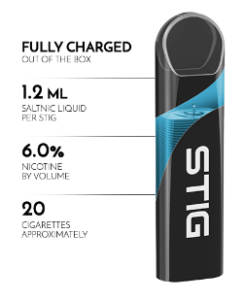

Temporary flavor ban
The Trump administration has instituted a temporary flavor ban on all pod/ cartridge-based systems, excluding menthol and tobacco flavors
Flavors in disposables and tank systems will still be allowed
Notes:
The flavor ban on all pre-filled pods and cartridges was announced in early January 2020 for all flavors except menthol and tobacco. Two-thirds of high school students who vape use menthol or mint flavors, making them nearly as popular as fruity flavors, according to the CDC’s National Youth Tobacco Survey.
Tank systems and disposable vape devices are not included in the flavor ban.
For example, the Puff Bar Disposable Pod Device (pictured on the right) is a portable vape system that offers 2% or 5% nicotine salt strength in flavors like strawberry, mint and pineapple lemonade for $6.95. Stig, another popular brand, comes in multiple flavors and sells for $20 for a 3-pack.
Companies will have the right to petition the FDA through the pre-market approval process to offer flavored cartridges and pods provided that they can show how they will deter use by youth.
In July 2020, the FDA issued warning letters to Puff Bar and other disposable e-cigarette and e-liquid companies to remove their flavored products from the market because they do not have the required premarket authorization.
_____________
Source: Food and Drug Administration (FDA). (2020). FDA finalizes enforcement policy on unauthorized flavored cartridge-based e-cigarettes that appeal to children, including fruit and mint. https://www.fda.gov/news-events/press-announcements/fda-finalizes-enforcement-policy-unauthorized-flavored-cartridge-based-e-cigarettes-appeal-children

Slide 50
Inadequate government regulation
No national restrictions on advertising
Slow phase-in of “Deeming Rule”
No ban on all flavors
No requirement that products be kept behind the counter
Counterfeit products sold in plain sight on social media
Notes:
Tobacco cigarettes are heavily regulated – no ads or flavors (other than tobacco and menthol). Unlike cigarettes, which have been prohibited from advertising on TV or the radio since 1971, there are no such restrictions on non-cigarette nicotine products.
The provisions of the 2016 deeming regulation are being phased in over the next several years. For example, while the minimum legal sale age of 18 and the ban on free samples took effect in August 2016, the disclosure of harmful or potentially harmful ingredients wasn’t required until August 2019.
As noted on the previous slide, the flavor ban only applies to single use cartridges and pods in ‘closed systems,’ so youth can fill their own cartridges with other flavors.
Public health advocates have suggested more restrictions, such as requiring all vaping products to be available only behind the counter in pharmacies (similar to the policies enacted for Sudafed).
Countless sellers of counterfeit products are hawking their products in plain sight on social media with seeming impunity, using the ease and anonymity of social media to reach a massive audience of young people who vape.
The bottom line is that the federal government has walked back threats to ban flavors and delayed regulation, basically allowing the industry to police itself.
_____________
Source: Public Health Law Center. (2017). Regulating electronic cigarettes & similar devices. https://www.publichealthlawcenter.org/sites/default/files/resources/tclc-guide-reg-ecigarettes-2016.pdf

Slide 51
What schools can do

Slide 52
Prevention
The main way to prevent nicotine addiction is to keep people from using nicotine products
Strategies that are implemented early work best
Effective approaches are comprehensive and involve:
  Education and awareness
  Appeal to students’ desires for independence and future success
  Reduced access and availability
  Early detection of risk, parent involvement
  Compassionate, health-based interventions that promote cessation and improved mental health
Notes:
So what can we do? Here’s the classic plan for preventing substance use in teens and young adults.
Start talking to students in middle school about the risks of vaping.
Educate and increase awareness of actual short- and long-term harms, but skip the scare tactics.
Appeal to sense of independence and rebellion. The most effective way we can educate teenagers is by showing them that these companies, both the classic tobacco industry as well as the vapor companies, are trying to get them addicted to their products so that they’ll use them for a long time. They’re trying to exploit young people as a way of making money. That tends to work. They realize that when they see a classmate smoking, that person has been manipulated and got hooked by these rich companies.
Reduce access and availability – report gas stations and convenience stores near the school that may be selling products to students.
School counselors may be able to help with early detection of risk (e.g., anxiety, depression, etc.).
Utilize health-based interventions that promote cessation and improved mental health.

Slide 53

Signs of student vaping
Frequent trips to the bathroom at the same time every day
Mood changes before and after leaving the room
Students hanging out in bathroom stalls together
Returning to class smelling of minty or sweet scents
Putting what appears to be thick markers or pens in their mouths; using colorful USB-like devices
Using lanyards or hoodies to hide vaping devices
Unexplained shifts in mood, behavior, academics
Notes:
Make sure teachers and other staff are aware of signs that indicate vaping, including:
Frequent trips to the bathroom at about the same time every day
Mood changes before and after leaving the room (may be irritable before leaving and seem less stressed upon return)
Hanging out in bathroom stalls together - teens report that there is a preferred bathroom where students vape together during breaks
Check pop-up ceiling (may find vaping devices)
Returning to class smelling of mint or fruity sweet scents
Putting what appear to be thick markers or pens in their mouths; using colorful USB-like devices which are vape pens
Using lanyards or hoodies to hide vaping devices. Kids will often vape in class when the teacher’s back is turned, blowing the aerosol into their hoodie.
Students displaying unusual or unexplained changes in mood, irritability, concentration, behavior, or academic performance.

Slide 54
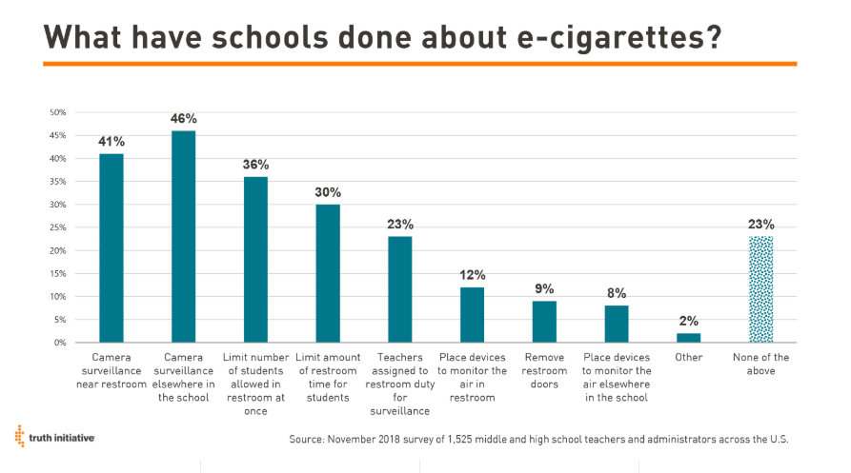
How some schools have approached vaping
Notes:
A Truth Initiative survey found that:
41% of teachers and administrators reported that their school uses camera surveillance near the school’s restroom
46% reported camera surveillance elsewhere in the school
23% reported using assigned teachers for restroom surveillance
9% reported removing restroom doors
34% reported no formal communication from the school to students’ parents about e-cigarette use at school
Just over 40% reported that their school sent a letter or email home, 28% reported phone calls, 22% had one-on-one meetings and 22% had PTA/town hall meetings as forms of communication with parents
__________________
Source: Truth Initiative. (2019). How are schools responding to JUUL and the youth e-cigarette epidemic? https://truthinitiative.org/research-resources/emerging-tobacco-products/how-are-schools-responding-juul-and-youth-e-cigarette

Slide 55
Addressing vaping in schools
Offer a research-based anti-vaping curriculum
Challenge students’ perceptions of norms (it’s not true that ‘everyone’ vapes)
Address the pull of addiction, reasons for use
Appeal to students’ desire for independence by demonstrating industry marketing tactics that target youth
Sponsor student-led anti-vaping campaigns
Offer alternative, safer means of having fun, reducing stress and taking risks
Notes:
Offer an anti-vaping curriculum, educating kids about the risks of vaping, challenging students’ perceived norms regarding how many kids vape, acknowledging the pull of nicotine addiction and appealing to students’ desire for independence by demonstrating how companies market their products to kids in order to make them dependent on nicotine and ensure long-term profits.
Let students create anti-vaping campaigns and share it with their peers.
Offer alternative, safer means for students to take risks, socialize, reduce stress and have fun.
__________________
Source: Examples of promising approaches: Katims, L. (2019, April 30). California fights vaping in schools. https://www.usnews.com/news/best-states/articles/2019-04-30/california-focuses-on-education-to-curb-vaping-in-schools

Slide 56
Helpful messages for teens
Don’t fall for it
  Don’t let big businesses take advantage of you, ruin your health, make you dependent
  It’s not cool to be addicted to and dependent on a drug
Don’t be fooled by celebrity and social media promotions
  There’s money behind them, not your best interests
Don’t contribute to environmental damage
Make smart and healthy choices
  Vaping really is dangerous
  You only have one brain and body and they’re in pretty great condition right now – why mess up your health?
Notes:
And what can we convey directly to teens that might help?
Don’t fall for it – don’t let big businesses like the tobacco industry take advantage of you.
Flip the script. Portray vaping as conformist instead of rebellious. Explain to kids that vaping companies are part of the cigarette industry. We need to show kids that by being 'rebellious' and vaping, they're doing exactly what the industry wants them to do.
Don’t be fooled by celebrity and social media promotions – there’s money behind them, not your best interests.
Don’t harm the environment with plastic waste from cannabis packaging and the electronic-cigarette cartridges used for vaping.
Make smart and healthy choices.
You only have one brain and body and, at this stage, they are in pretty great condition – why mess with it?
A recent study found that just focusing on addiction wasn’t enough to convince kids – they jokingly refer to themselves as addicted to chocolate, other food, their phones or coffee. Instead, participants wanted more facts about the negative consequences of vaping. Messages associated with the health effects resonated most for teens.
__________________
Source:
Roditis et al. (2019). Reactions to electronic nicotine delivery system (ENDS) prevention messages: Results from qualitative research used to inform FDA's first youth ENDS prevention campaign. https://tobaccocontrol.bmj.com/content/early/2019/09/10/tobaccocontrol-2019-055104

Slide 57
What schools can do
Be vigilant about places on campus where students vape
  e.g., check pop-up ceilings in bathrooms where vaping devices may be hidden, school parking lots
Track vaping and other tobacco use trends in school/district and adjust approaches accordingly
Educate staff, parents/caregivers on the harms of vaping and on how to respond effectively to youth vaping
Identify and intervene with students who vape using a health rather than a punitive approach
  Nicotine addiction is powerful and difficult to overcome
Share community resources that can provide assistance
Notes:
Be attuned to popular vaping venues on campus and intervene appropriately.
Use surveys to track use and progress, and adjust approaches accordingly.
Educate staff on the harms of vaping and how to recognize it in the classroom and elsewhere on school property.
Host community events to educate parents and caregivers. Many schools have held panels including clinicians, pulmonologists and substance use experts to explain the basics, the risks of vaping and how to respond.
Rather than punish students who are vaping, identify students in need of help and get them treatment. Some schools are creating support groups for teens who want to quit.
Share community resources such as professional counseling supports, quitlines and support groups.
The state of Massachusetts has developed a toolkit for its schools that includes useful information as to how schools can address e-cigarette use. http://makesmokinghistory.org/wp-content/uploads/2018/08/VapingToolkit2018.pdf

Slide 58
Youth-friendly materials
CATCH My Breath – CATCH (Coordinated Approach to Child Health)
  Prevention program for ages 11-18; 4 sessions lasting 35-40 minutes each
  Cooperative learning groups, group discussions, goal setting, interviews, media literacy
The Tobacco Prevention Toolkit – Stanford University School of Medicine
  In-classroom units and lesson plans on e-cigarettes, tobacco and nicotine
  Includes PowerPoints, discussion guides, worksheets and activities
ASPIRE -- MD Anderson Center
  Free, bilingual, online tool that helps students learn about being tobacco free
Notes:
Here, and on the next slide, are some youth-oriented presentations, curricula and other materials and resources for schools to use with students.

Slide 59
Youth-friendly materials
smokeSCREEN -- a smoking prevention videogame – play2PREVENT
Get Smart about Tobacco: Health and Science Education Program – Scholastic
The Real Cost of Vaping – FDA and Scholastic
  Information and a single lesson plan for grades 9-12
Know the Risks: A Youth Guide to E-cigarettes–CDC's Office on Smoking & Health

Slide 60
Additional Resources

Slide 61
Helpful resources
Partnership to End Addiction guide – Vaping: What School Professionals Need to Know to Help Protect Children, Teens and Young Adults: https://drugfree.org/community-resources/
Centers for Disease Control and Prevention (CDC): https://www.cdc.gov/tobacco/basic_information/e-cigarettes/index.htm
Stanford’s Tobacco Prevention Toolkit:
https://med.stanford.edu/tobaccopreventiontoolkit/E-Cigs.html
Truth Initiative’s quitting resources: https://truthinitiative.org/thisisquitting
Notes:
What are good resources?
Partnership to End Addiction has a downloadable guide available on our web site dedicated to this issue as well as countless other valuable resources for parents and communities on vaping, marijuana and other teen substance use.
The Centers for Disease Control and Prevention has great facts and statistics on youth and adult vaping.
The Tobacco Prevention Toolkit, by researchers at Stanford, has a significant unit on vaping and Juuls. Frequently updated, it has photos, charts and points of discussion.
Truth Initiative, the nonprofit organization behind the extremely successful youth tobacco prevention campaign, has expanded its quit-smoking resources to include an e-cigarette quit program. This free text message program was created with input from teens, college students and young adults who have attempted to, or successfully quit, e-cigarettes.

Slide 62
Contact
Pat Aussem
paussem@toendaddiction.org
Linda Richter
lrichter@toendaddiction.org

Slide 63
© 2020 Partnership to End Addiction

